Slide 1

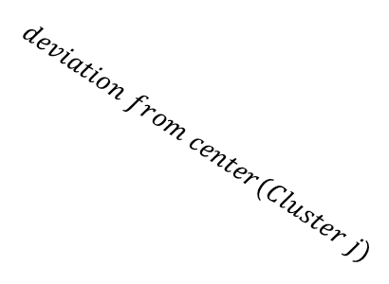


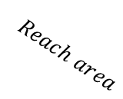
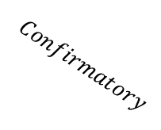
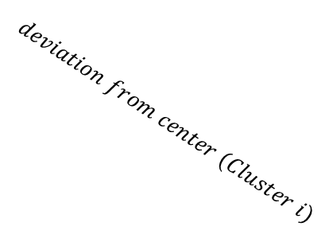
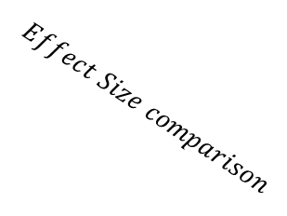
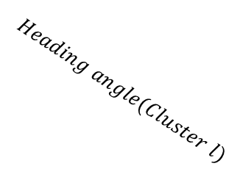
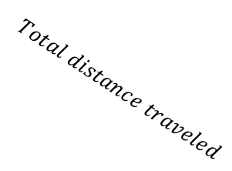
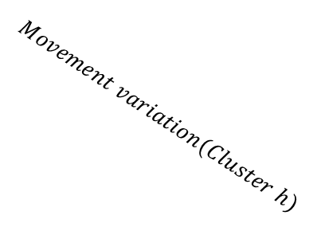

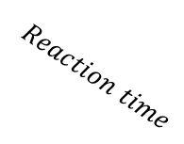
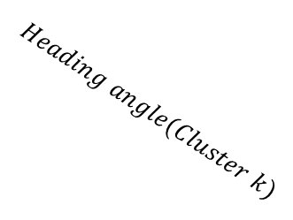
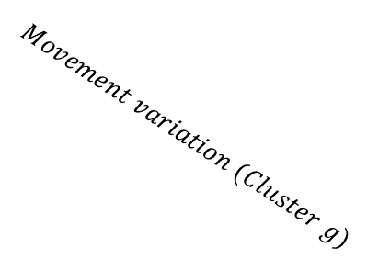
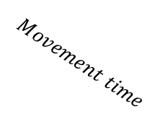
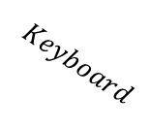
With time series variables
$$Effect Size comparison$$
$$Reach$$
$$Keyboard$$
$$Exploratory$$
$$Confirmatory$$
$$Reaction time$$
$$Movement time$$
$$COM$$
$$Total distance traveled$$
$$Reach area$$
$$RT$$
$$deviation from center (Cluster i)$$
$$deviation from center(Cluster j)$$
$$Movement variation (Cluster g)$$
$$Movement variation(Cluster h)$$
$$Heading angle(Cluster k)$$
$$Heading angle(Cluster l)$$
Permutation + Clustering
Deviation
from center
i
j
Proportion of Z traveled

Slide 2
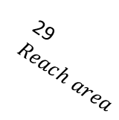
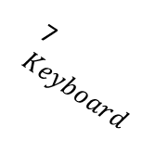
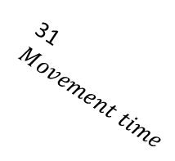
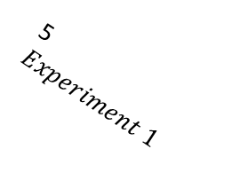
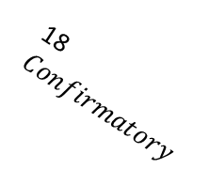
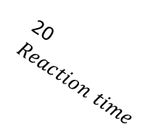


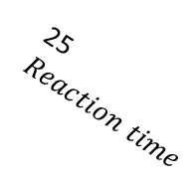
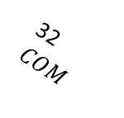
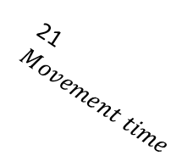
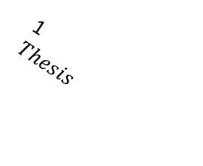
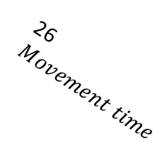
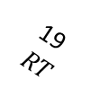
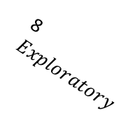
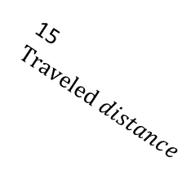

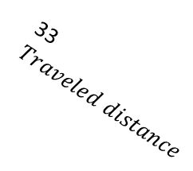

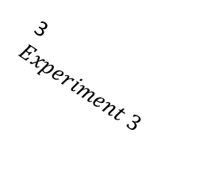

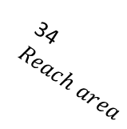
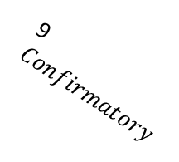
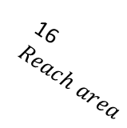
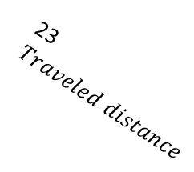
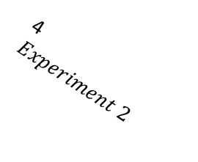
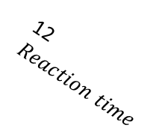
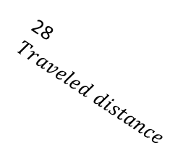

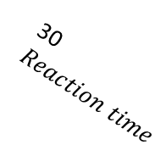
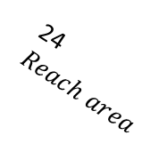
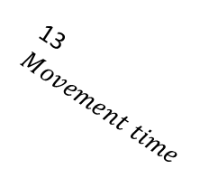
W/o time series variables
1
$Thesis$
2
Experiment 4
3
$Experiment 3$
4
$Experiment 2$
5
$Experiment 1$
7$Keyboard$
8$Exploratory$
14$COM$
15$Traveled distance$
16$Reach area$
9
$Confirmatory$
10$Exploratory$
11$Confirmatory$
12$Reaction time$
6
Reaching
13$Movement time$
19$RT$
20$Reaction time$
21$Movement time$
22$COM$
23$Traveled distance$
24$Reach area$
25$Reaction time$
17$Exploratory$
18$Confirmatory$
26$Movement time$
27$COM$
28$Traveled distance$
29$Reach area$
30$Reaction time$
31$Movement time$
32$COM$
33$Traveled distance$
34$Reach area$

Slide 3
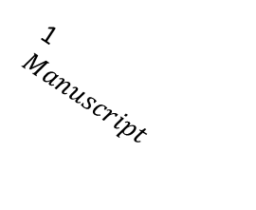
1
$Manuscript$
2
Experiment 4
3
$Experiment 3$
4
$Experiment 2$
5
$Experiment 1$
7$Keyboard$
8$Exploratory$
14$COM$
15$Traveled distance$
16$Reach area$
9
$Confirmatory$
10$Exploratory$
11$Confirmatory$
12$Reaction time$
6
Reaching
13$Movement time$
19$RT$
20$Reaction time$
21$Movement time$
22$COM$
23$Traveled distance$
24$Reach area$
25$Reaction time$
17$Exploratory$
18$Confirmatory$
26$Movement time$
27$COM$
28$Traveled distance$
29$Reach area$
30$Reaction time$
31$Movement time$
32$COM$
33$Traveled distance$
34$Reach area$

Slide 4
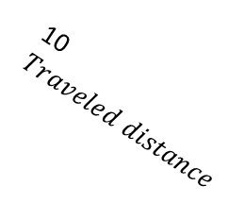
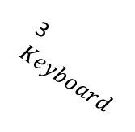
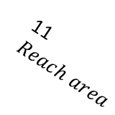
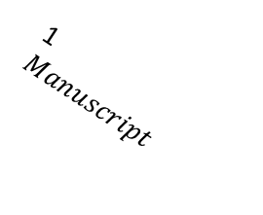

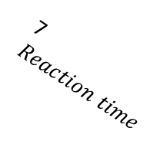
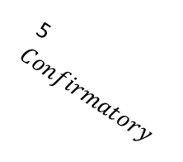


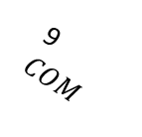
Only Exp 4
1
$Manuscript$
2
Reaching
3$Keyboard$
4$Exploratory$
6$RT$
5$Confirmatory$
7$Reaction time$
9 $COM$
8$Movement time$
10$Traveled distance$
11$Reach area$

